Slide 1
Introduction To Genetic Algorithms
1
Swarup Kr Ghosh

Slide 2
References
2
D. E. Goldberg, ‘Genetic Algorithm In Search, Optimization And Machine Learning’, New York: Addison – Wesley (1989)
John H. Holland ‘Genetic Algorithms’, Scientific American Journal, July 1992.
Kalyanmoy Deb, ‘An Introduction To Genetic Algorithms’, Sadhana, Vol. 24 Parts 4 And 5.

Slide 3
Introduction to optimization
3
Global optima
Local optima
Local optima
Local optima Local optima
f
X
7 November 2013

Slide 4
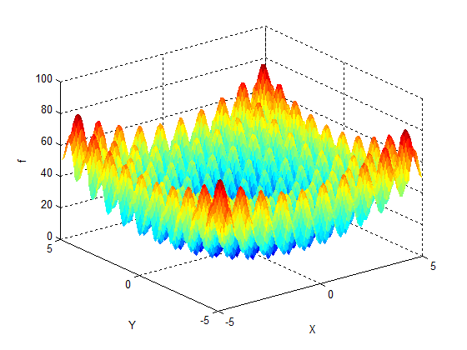
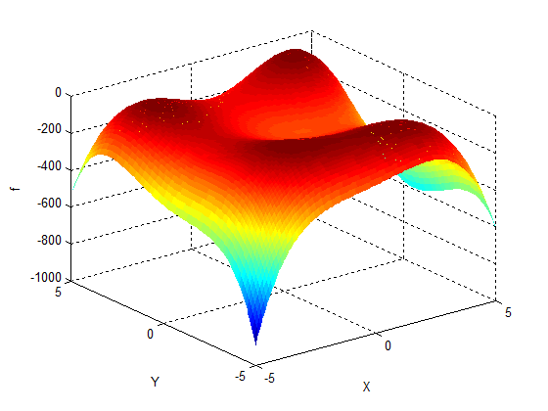
Introduction to optimization
4
Multiple optimal solutions

Slide 5
Genetic Algorithms
5
Genetic Algorithms are the heuristic search and optimization techniques that mimic the process of natural evolution.

Slide 6
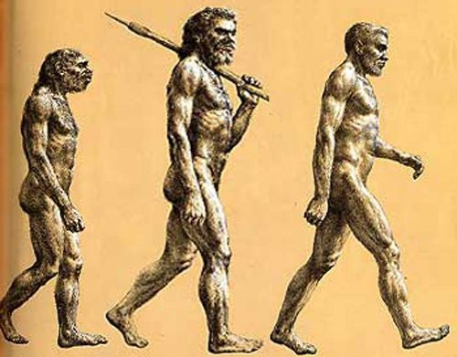
Principle Of Natural Selection
6
“Select The Best, Discard
The Rest”

Slide 7
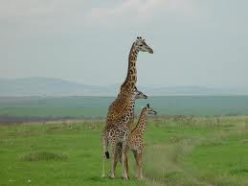
An Example….
7
Giraffes have long necks
□ Giraffes with slightly longer necks could feed on
leaves of higher branches when all lower ones had
been eaten off.
They had a better chance of survival.
Favorable characteristic propagated through generations of giraffes.
Now, evolved species has long necks.

Slide 8
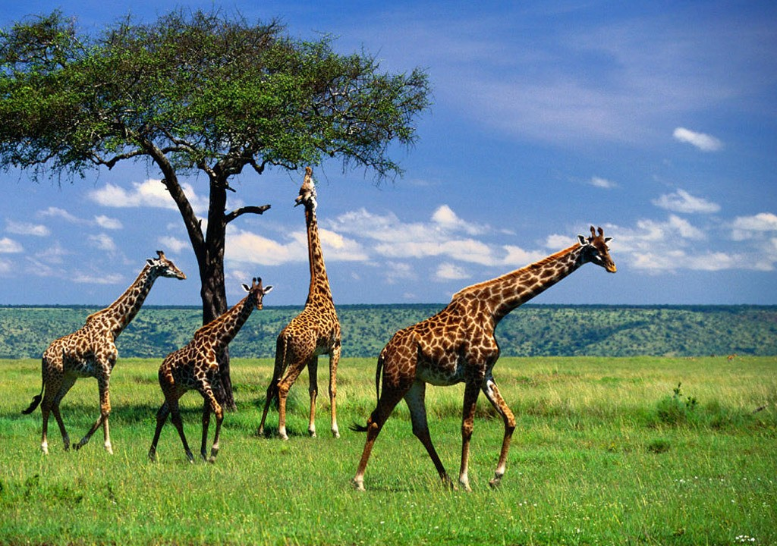
An Example….
8
This longer necks may have due to the effect of mutation initially. However as it was favorable, this was propagated over the generations.

Slide 9
Evolution of species
9
Initial Population of animals
Struggle For Existence Survival Of the Fittest
Millions Of
Years
Surviving Individuals Reproduce, Propagate Favorable Characteristics
Evolved Species

Slide 10



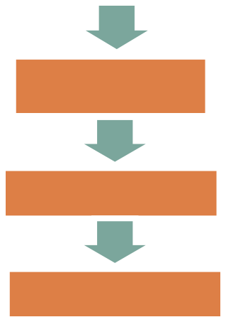
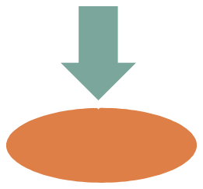
Simple Genetic Algorithms
11
Start
Initialize
population
Evaluate Solutions
T = 0
NO
Optimum Solution?
YES
Selection
T=T+1
Stop
Crossover
7
Mutation
November 2013

Slide 11
Simple Genetic Algorithm
12
function sga ()
{
Initialize population; Calculate fitness function;
While(fitness value != termination criteria)
{
Selection;
Crossover; Mutation;
Calculate fitness function;
}
}

Slide 12
GA Operators and Parameters
13
Selection
Crossover
Mutation
Now we will discuss about genetic operators

Slide 13
Selection
14
The process that determines which solutions are to be preserved and allowed to reproduce and which ones deserve to die out.
The primary objective of the selection operator is to emphasize the good solutions and eliminate the bad solutions in a population while keeping the population size constant.
“Selects the best, discards the rest”

Slide 14
Functions of Selection operator
15
Identify the good solutions in a population
Make multiple copies of the good solutions Eliminate bad solutions from the population so that
multiple copies of good solutions can be placed in the
population
Now how to identify the good solutions?

Slide 15
Fitness function
16
A fitness value can be assigned to evaluate the solutions
A fitness function value quantifies the optimality of a solution. The value is used to rank a particular solution against all the other solutions
A fitness value is assigned to each solution depending on how close it is actually to the optimal solution of the problem

Slide 16
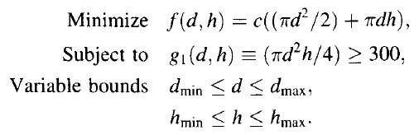

Assigning a fitness value
17
Considering c = 0.0654
23
d
h

Slide 17
Selection operator
18
There are different techniques to implement selection in Genetic Algorithms.
They are:
Tournament selection
Roulette wheel selection
Proportionate selection
Rank selection
Steady state selection, etc

Slide 18
Tournament selection
19
In tournament selection several tournaments are played among a few individuals. The individuals are chosen at random from the population.
The winner of each tournament is selected for next generation.
Selection pressure can be adjusted by changing the tournament size.
Weak individuals have a smaller chance to be selected if tournament size is large.

Slide 19
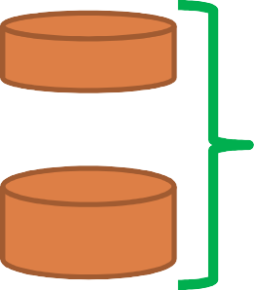
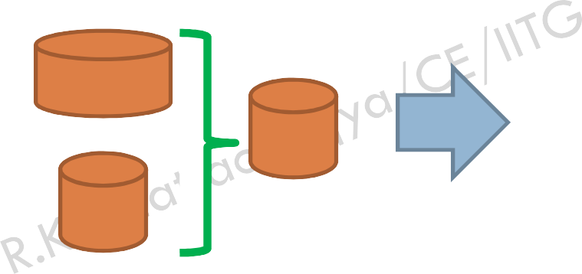
Tournament selection
20
Selected
22
32
22
25
25
22
25
13
+30
32
22
32
40
32
22
13
+30
25
40
22
Best solution will have two copies Worse solution will have no copies
Other solutions will have two, one or zero copies
₇ +45
₇ +45
25
13
+30
25
13
+30

Slide 20

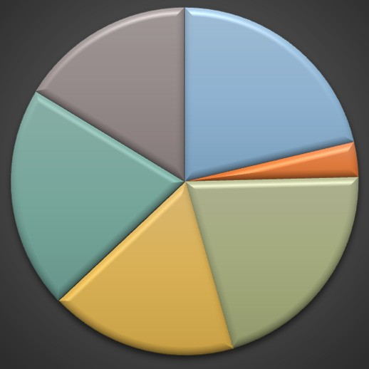
Roulette wheel and proportionate selection
21
Chrom # | Fitness | % of RW | EC | AC
1 | 50 | 26.88 | 1.61 | 2
2 | 6 | 3.47 | 0.19 | 0
3 | 36 | 20.81 | 1.16 | 1
4 | 30 | 17.34 | 0.97 | 1
5 | 36 | 20.81 | 1.16 | 1
6 | 28 | 16.18 | 0.90 | 1
 | 186 | 100.00 | 6 | 6
Parents are selected according to their fitness values
The better chromosomes have more chances to be selected
₆ Roulet wheel
16%
1
21%
2
3%
5
21%
3
21%
4
18%
7 N

Slide 21
Rank selection
22
Chrom # | Fitness
1 | 37
2 | 6
3 | 36
4 | 30
5 | 36
6 | 28
Sort according to fitness
Chrom # | Fitness
1 | 37
3 | 36
5 | 36
4 | 30
6 | 28
2 | 6
Assign raking
Chrom # | Rank
1 | 6
3 | 5
5 | 4
4 | 3
6 | 2
2 | 1
Chrom # | % of RW
1 | 29
3 | 24
5 | 19
4 | 14
6 | 10
2 | 5
Roulette wheel
Chrom # | EC | AC
1 | 1.714 | 2
3 | 1.429 | 1
5 | 1.143 | 1
4 | 0.857 | 1
6 | 0.571 | 1
2 | 0.286 | 0
6 5 4 3 2 1
7 Nove
mber 2013

Slide 22
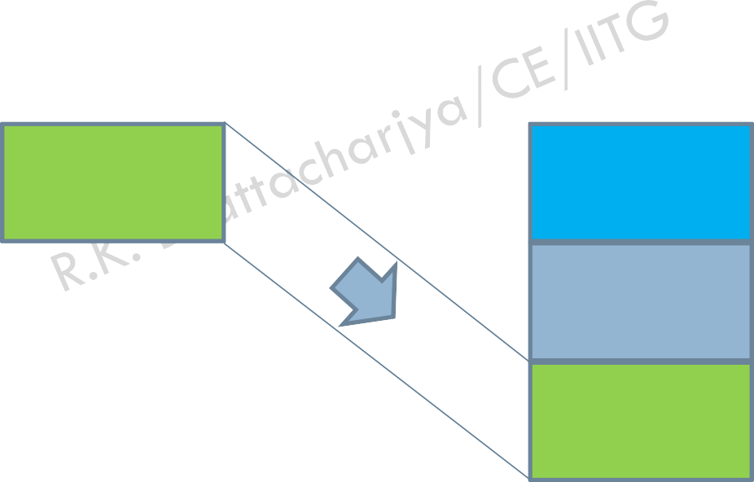
Steady state selection
23
In this method, a few good chromosomes are used for creating new offspring in every iteration.
Then some bad chromosomes are removed and the new offspring is placed in their places
The rest of population migrates to the next generation without going through the selection process.
Good
New offspring
Good
Bad
New offspring

Slide 23
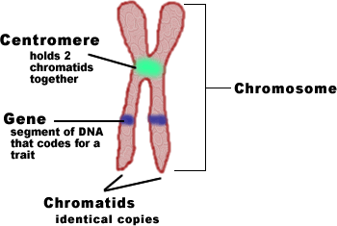
How to implement crossover
24
The crossover operator is used to create new solutions from the existing solutions available in the mating pool after applying selection operator.
This operator exchanges the gene information between the solutions in the mating pool.
0 | 1 | 0 | 0 | 1 | 1 | 0 | 1 | 1 | 0
Encoding of solution is necessary so that our solutions look like a chromosome
Source: http://www.biologycorner.com/bio1/celldivision-chromosomes.html

Slide 24
Encoding
25
The process of representing a solution in the form of a string that conveys the necessary information.
Just as in a chromosome, each gene controls a particular characteristic of the individual, similarly, each bit in the string represents a characteristic of the solution.

Slide 25
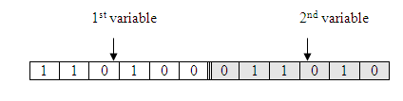


Encoding Methods
26
□ Most common method of encoding is binary coded. Chromosomes are strings of 1 and 0 and each position in the chromosome represents a particular characteristic of the problem
Decoded value
52
26
Mapping between decimal and binary value

Slide 26
Encoding Methods
27
Defining a string
[0100001010]
d h
h
(d,h) = (8,10) cm
Chromosome = [0100001010]
d

Slide 27
Crossover operator
28
The most popular crossover selects any two solutions strings randomly from the mating pool and some portion of the strings is exchanged between the strings.
The selection point is selected randomly.
A probability of crossover is also introduced in order to give freedom to an individual solution string to determine whether the solution would go for crossover or not.
Solution 1
Solution 2
Child 1
Child 2

Slide 28
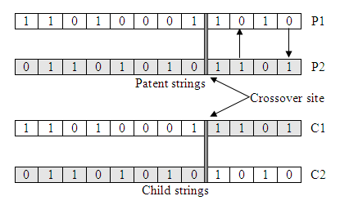
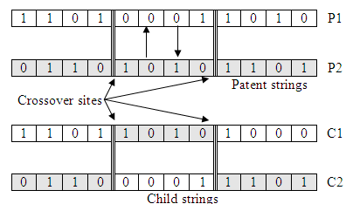
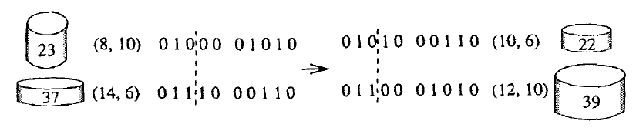
Binary Crossover
29
Source: Deb 1999

Slide 29
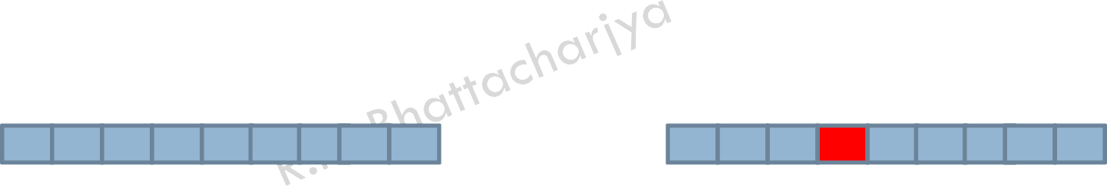
Mutation operator
30
Mutation is the occasional introduction of new features in to the solution strings of the population pool to maintain diversity in the population.
Though crossover has the main responsibility to search for the optimal solution, mutation is also used for this purpose.
Before mutation
After mutation

Slide 30
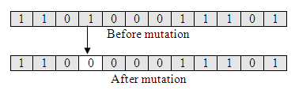
Binary Mutation
31
Mutation operator changes a 1 to 0 or vise versa, with a mutation probability of .
The mutation probability is generally kept low for steady convergence.
A high value of mutation probability would search here and there like a random search technique.
Source: Deb 1999

Slide 31
Nature to Computer Mapping
33
Nature | Computer
Population | Set of solutions
Individual | Solution to a problem
Fitness | Quality of a solution
Chromosome | Encoding for a solution
Gene | Part of the encoding solution

Slide 32


An example problem
34
Consider 6 bit string to represent the solution, then 000000 = 0 and 111111 =
Assume population size of 4
Let us solve this problem by hand calculation

Slide 33



An example problem
35
Initialize population
Calculate decoded value
Calculate real value
Calculate objective function value
Calculate actual
count
Calculate
expected count
Calculate relative
fitness value
Calculate fitness
value
Initial population
Decoding
Fitness calculation
f F
Selection: Proportionate selection
Sol No
Binary String
DV x
value
Relative Fitness
Expected count
Actual count
1 100101 37 0.587 0.96 0.96 0.38
2 001100 12 0.19 0.56 0.56 0.22
3 111010 58 0.921 0.25 0.25 0.10
4 101110 46 0.73 0.75 0.75 0.30
Avg
1.53
2
0.89
1
0.39
0
1.19
1
0.563
Max 0.96

Slide 34

An example problem: Crossover
36
Matting pool
Random generation of
crossover site
New population
Crossover: Single point
Sol No | Matting pool | CS | New Binary String | DV | x value | f | F
1 | 100101 | 3 | 100100 | 36 | 0.57 | 0.97 | 0.97
2 | 001100 | 3 | 001101 | 13 | 0.21 | 0.60 | 0.60
3 | 100101 | 2 | 101110 | 46 | 0.73 | 0.75 | 0.75
4 | 101110 | 2 | 100101 | 37 | 0.59 | 0.96 | 0.96
 |  |  |  |  |  | Avg | 0.8223
 |  |  |  |  |  | Max | 0.97

Slide 35
An example problem: Mutation
37
 | Mutation
Sol No | Population after crossover | Population after mutation | DV | x value | f | F
1 | 100100 | 100000 | 32 | 0.51 | 1.00 | 1.00
2 | 001101 | 101101 | 45 | 0.71 | 0.78 | 0.78
3 | 101110 | 100110 | 38 | 0.60 | 0.95 | 0.95
4 | 100101 | 101101 | 45 | 0.71 | 0.78 | 0.78
 |  |  |  |  | Avg | 0.878
 |  |  |  |  | Max | 1.00

Slide 36
Real coded Genetic Algorithms
38
Disadvantage of binary coded GA
more computation
lower accuracy
longer computing time
solution space discontinuity
hamming cliff

Slide 37
Real coded Genetic Algorithms
39
The standard genetic algorithms has the following steps
Choose initial population
Assign a fitness function
Perform elitism
Perform selection
Perform crossover
Perform mutation
□ In case of standard Genetic Algorithms, steps 5 and 6 require bitwise manipulation.

Slide 38
Real coded Genetic Algorithms
40
Simple crossover: similar to binary crossover
P1 P2
8 | 6 | 3 | 7 | 6
2 | 9 | 4 | 8 | 9
C1 C2
8 | 6 | 4 | 8 | 9
2 | 9 | 3 | 7 | 6

Slide 39
Real coded Genetic Algorithms
41
Linear Crossover
Parents: (x₁,…,x_{n} ) and (y₁,…,y_{n} )
Select a single gene (k) at random
Three children are created as,
(x₁ , ..., x_{k} , 0.5 ⋅ y_{k} + 0.5 ⋅ x_{k} , ..., x_{n} )
(x₁ , ..., x_{k} ,1.5 ⋅ y_{k} − 0.5 ⋅ x_{k} , ..., x_{n} )
(x₁, ..., x_{k} , - 0.5 ⋅ y_{k} +1.5 ⋅ x_{k} , ..., x_{n} )
From the three children, best two are selected for the next generation

Slide 40
Real coded Genetic Algorithms
42
Single arithmetic crossover
Parents: (x₁,…,x_{n} ) and (y₁,…,y_{n} )
Select a single gene (k) at random
child₁ is created as,
(x₁, ..., x_{k} , α ⋅ y_{k} + (1− α ) ⋅ x_{k} , ..., x_{n} )
reverse for other child. e.g. with α = 0.5
0.5 | 0.7 | 0.7 | 0.5 | 0.2 | 0.8 | 0.3 | 0.9 | 0.4
0.5 | 0.7 | 0.7 | 0.5 | 0.2 | 0.5 | 0.3 | 0.9 | 0.4
0.1 | 0.3 | 0.1 | 0.3 | 0.7 | 0.2 | 0.5 | 0.1 | 0.2
0.1 | 0.3 | 0.1 | 0.3 | 0.7 | 0.5 | 0.5 | 0.1 | 0.2

Slide 41
Real coded Genetic Algorithms
43
Simple arithmetic crossover
Parents: (x₁,…,x_{n} ) and (y₁,…,y_{n} )
Pick random gene (k) after this point mix values
child₁ is created as:
(x , ..., x , α ⋅ y
+ (1− α ) ⋅ x , ..., α ⋅ y + (1− α ) ⋅ x )
1 k k +1 k +1 n
n
reverse for other child. e.g. with α = 0.5
0.5 | 0.7 | 0.7 | 0.5 | 0.2 | 0.8 | 0.3 | 0.9 | 0.4
0.1 | 0.3 | 0.1 | 0.3 | 0.7 | 0.2 | 0.5 | 0.1 | 0.2
0.5 | 0.7 | 0.7 | 0.5 | 0.2 | 0.5 | 0.4 | 0.5 | 0.3
0.1 | 0.3 | 0.1 | 0.3 | 0.7 | 0.5 | 0.4 | 0.5 | 0.3

Slide 42
Real coded Genetic Algorithms
44
Whole arithmetic crossover
Most commonly used
Parents: (x₁,…,x_{n} ) and (y₁,…,y_{n} )
child₁ is:
α ⋅ x + (1− α ) ⋅ y
reverse for other child. e.g. with α = 0.5
0.5 | 0.7 | 0.7 | 0.5 | 0.2 | 0.8 | 0.3 | 0.9 | 0.4
0.3 | 0.5 | 0.4 | 0.4 | 0.4 | 0.5 | 0.4 | 0.5 | 0.3
0.1 | 0.3 | 0.1 | 0.3 | 0.6 | 0.2 | 0.5 | 0.1 | 0.2
0.3 | 0.5 | 0.4 | 0.4 | 0.4 | 0.5 | 0.4 | 0.5 | 0.3

Slide 43
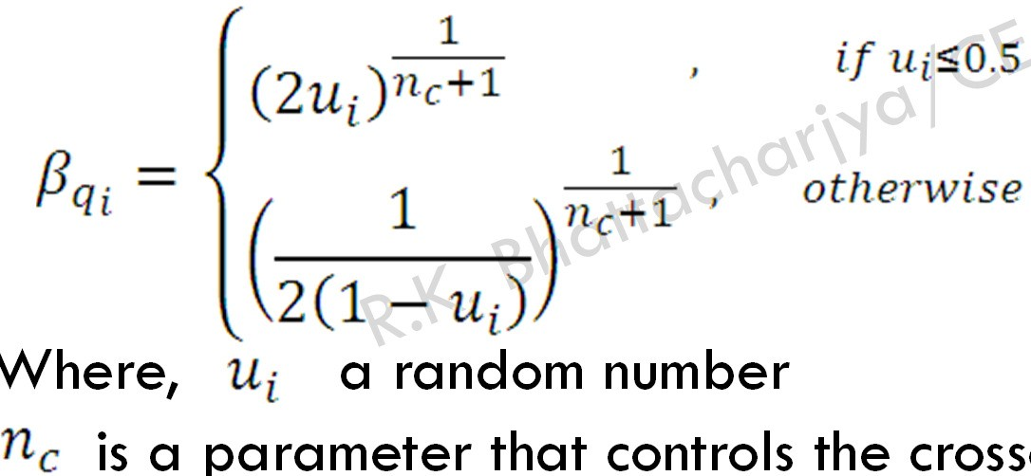
Simulated binary crossover
45
□ Developed by Deb and Agrawal, 1995)
Where, a random number
is a parameter that controls the crossover process. A high value of the parameter will create near-parent solution

Slide 44
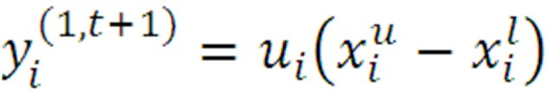

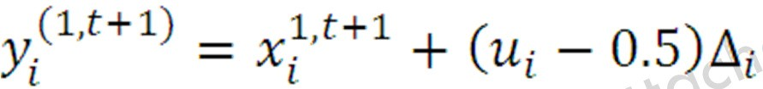

Random mutation
46
Where
is a random number between [0,1]
Where,
is the user defined maximum
perturbation

Slide 45
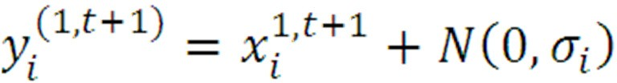

Normally distributed mutation
47
A simple and popular method
Where
is the Gaussian probability distribution with zero mean

Slide 46
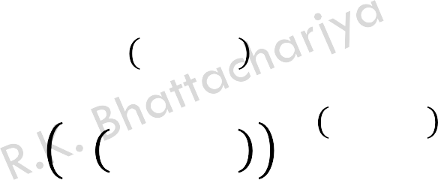
Polynomial mutation
48
Deb and Goyal,1996 proposed
_{y}1,t+1 _{= x}1,t+1 ₊
i i
x^{u} − x^{S} ð_{i}
i i
2u_{i}
1/ y_{n}+1
− 1
1/ y_{n}+1
If u_{i} < 0.5
ð_{i} = [
1 − 2 1 − u_{i}
If u ≥ 0.5
i

Slide 47
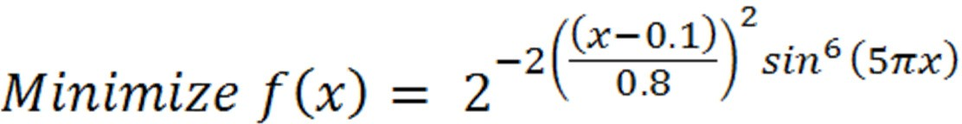

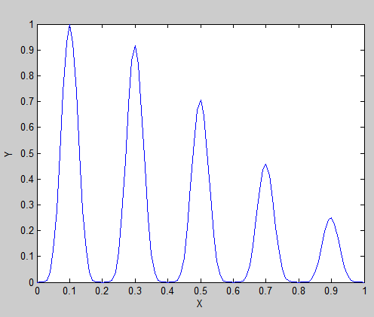
Multi-modal optimization
49
Solve this problem using simple Genetic Algorithms
7 November 2013

Slide 48
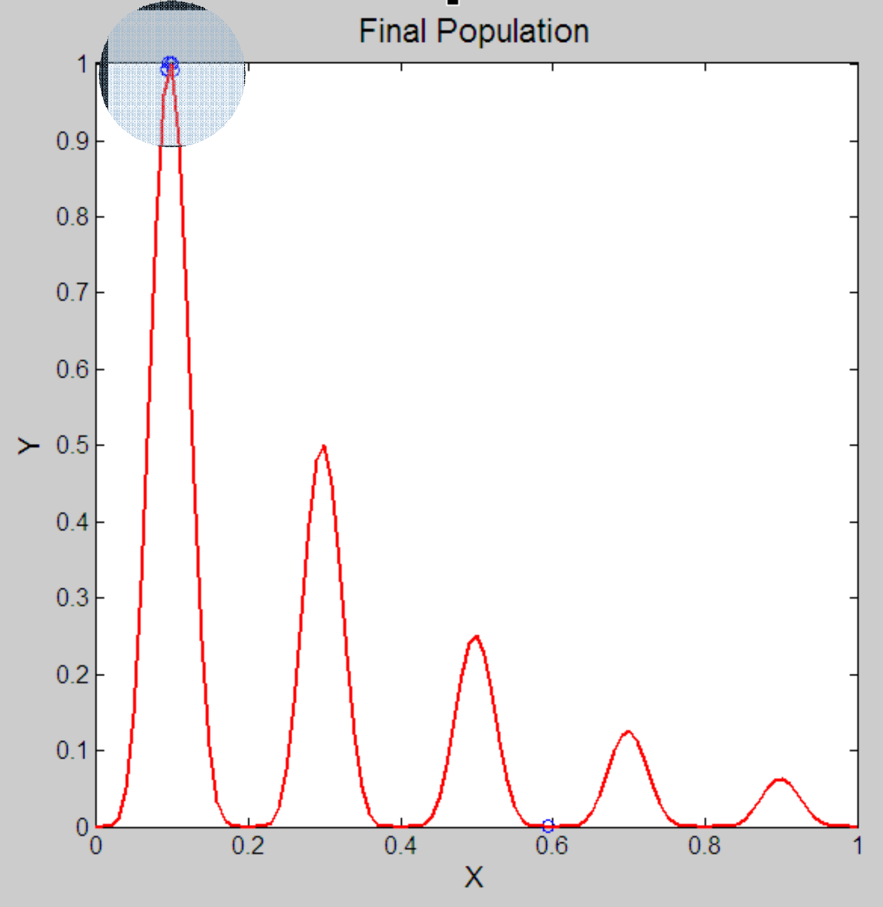
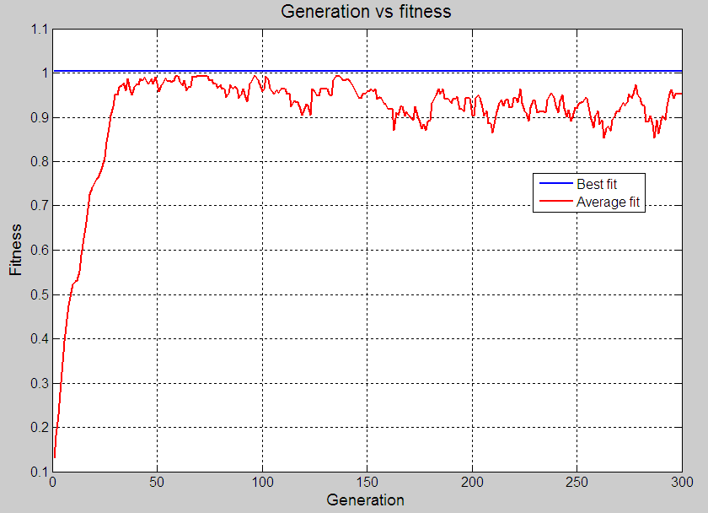
After Generation 200
50
The population are in and around the global optimal solution

Slide 49

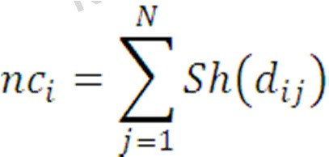
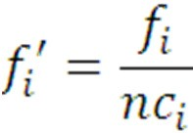
Multi-modal optimization
51
Simple modification of Simple Genetic Algorithms can capture all the optimal solution of the problem including global optimal solutions
Basic idea is that reduce the fitness of crowded solution, which can be implemented using following three steps.
Sharing function
Niche count Modified fitness

Slide 50


Hand calculation
52
Maximize
Sol | String | Decoded value | x | f
1 | 110100 | 52 | 1.651 | 0.890
2 | 101100 | 44 | 1.397 | 0.942
3 | 011101 | 29 | 0.921 | 0.246
4 | 001011 | 11 | 0.349 | 0.890
5 | 110000 | 48 | 1.524 | 0.997
6 | 101110 | 46 | 1.460 | 0.992

Slide 51
Distance table
53
dij | 1 | 2 | 3 | 4 | 5 | 6
1 | 0 | 0.254 | 0.73 | 1.302 | 0.127 | 0.191
2 | 0.254 | 0 | 0.476 | 1.048 | 0.127 | 0.063
3 | 0.73 | 0.476 | 0 | 0.572 | 0.603 | 0.539
4 | 1.302 | 1.048 | 0.572 | 0 | 1.175 | 1.111
5 | 0.127 | 0.127 | 0.603 | 1.175 | 0 | 0.064
6 | 0.191 | 0.063 | 0.539 | 1.111 | 0.064 | 0

Slide 52
Sharing function values
54
sh(dij) | 1 | 2 | 3 | 4 | 5 | 6 | nc
1 | 1 | 0.492 | 0 | 0 | 0.746 | 0.618 | 2.856
2 | 0.492 | 1 | 0.048 | 0 | 0.746 | 0.874 | 3.16
3 | 0 | 0.048 | 1 | 0 | 0 | 0 | 1.048
4 | 0 | 0 | 0 | 1 | 0 | 0 | 1
5 | 0.746 | 0.746 | 0 | 0 | 1 | 0.872 | 3.364
6 | 0.618 | 0.874 | 0 | 0 | 0.872 | 1 | 3.364

Slide 53
Sharing fitness value
55
Sol | String | Decoded value | x | f | nc | f’
1 | 110100 | 52 | 1.651 | 0.890 | 2.856 | 0.312
2 | 101100 | 44 | 1.397 | 0.942 | 3.160 | 0.300
3 | 011101 | 29 | 0.921 | 0.246 | 1.048 | 0.235
4 | 001011 | 11 | 0.349 | 0.890 | 1.000 | 0.890
5 | 110000 | 48 | 1.524 | 0.997 | 3.364 | 0.296
6 | 101110 | 46 | 1.460 | 0.992 | 3.364 | 0.295

Slide 54
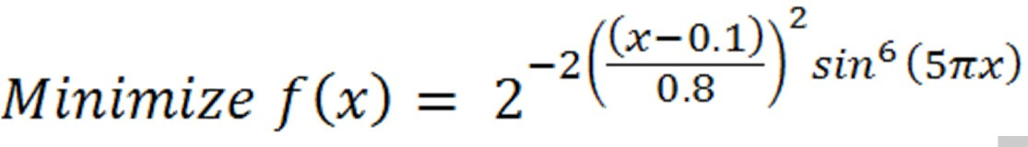
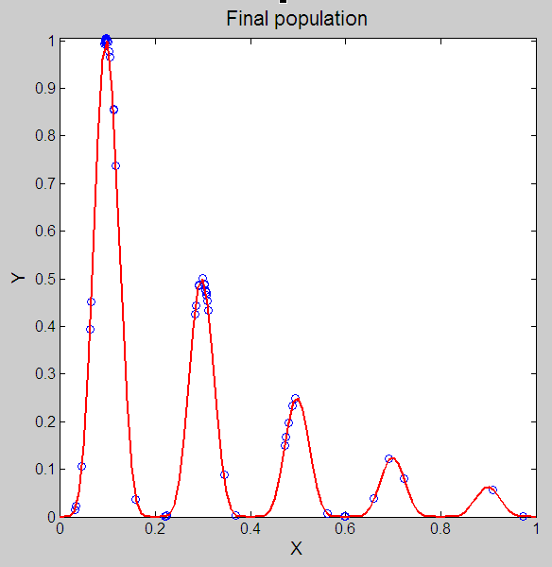
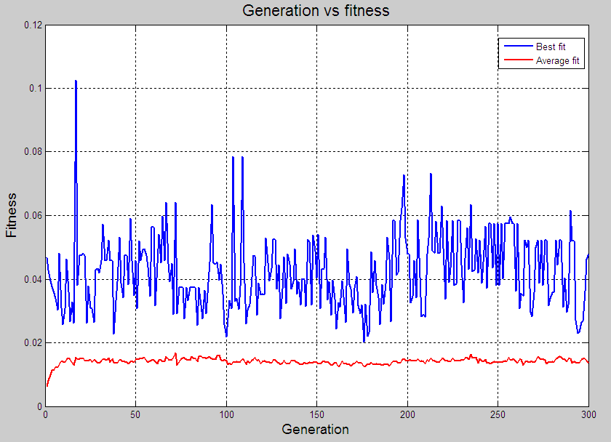
Solutions obtained using modified fitness value
56

Slide 55
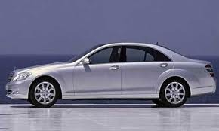

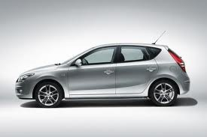
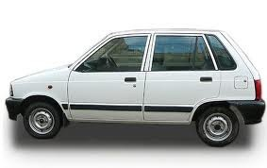
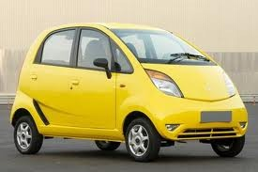
Multi-objective optimization
68
Comfort
Price

Slide 56
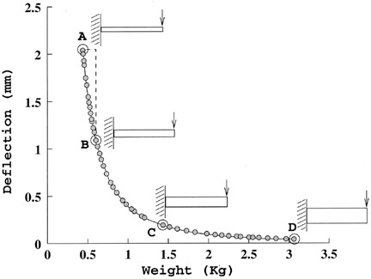
Multi-objective optimization
69
Two objectives are
Minimize weight
Minimize deflection

Slide 57
Multi-objective optimization
70
More than one objectives
Objectives are conflicting in nature
Dealing with two search space
Decision variable space
Objective space
Unique mapping between the objectives and often the mapping is non-linear
Properties of the two search space are not similar
Proximity of two solutions in one search space does not mean a proximity in other search space

Slide 58
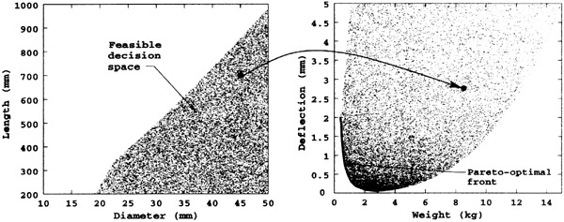
Multi-objective optimization
71

Slide 59






Vector Evaluated Genetic Algorithm (VEGA)
72
f1
P1
f2
f3 f4
P2
P3
Crossover and Mutation
P4
…
…
fn Pn
Old population Mating pool
Propose by Schaffer (1984)
New population

Slide 60

Non-dominated selection heuristic
73
Give more emphasize on the non-dominated solutions of the population
This can be implemented by subtracting ∈ from the dominated solution fitness value
Suppose N^{u} is the number of sub-population and n^{u} is the non-dominated solutions. Then total reduction is N^{u} − n^{u} ∈.
The total reduction is then redistributed among the non-dominated solution by adding an amount N^{u} − n^{u} ∈/n^{u}
This method has two main implications
Non-dominated solutions are given more importance
Additional equal emphasis has been given to all the non-dominated solution

Slide 61
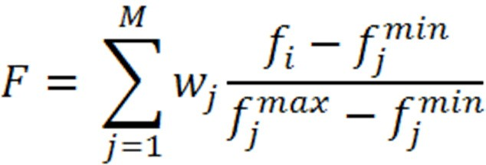
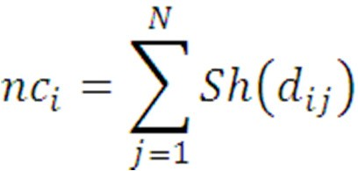
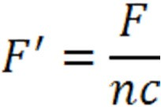
Weighted based genetic algorithm (WBGA)
74
□ The fitness is calculated
□ The spread is maintained using the sharing function approach
Sharing function
Niche count
Modified fitness

Slide 62
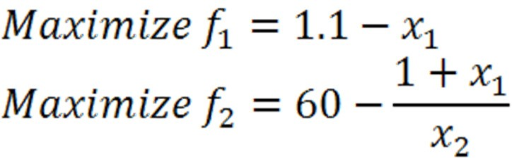
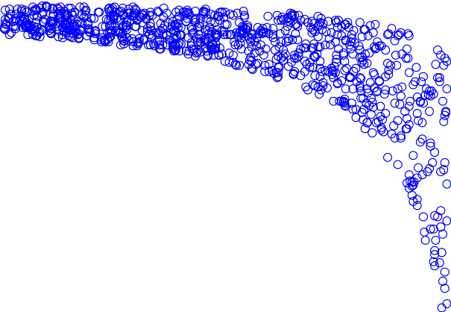



Multiple objective genetic algorithm (MOGA)
75
5
4.5
4
3.5
3
2.5
2
1.5
1
0.5
0
0.1
0.2
0.3
0.4
0.7
0.8
0.9
1

Slide 63
Initialize population of size N
Calculate all the objective functions
Rank the population according to non- dominating criteria
Selection
No
Crossover
Termination Criteria?
Yes
Mutation
Calculate objective function of the new population
Pareto-optimal solution
Combine old and new population
Non-dominating ranking on the combined population
Calculate crowding distance of all the solutions
Get the N member from the combined population on the basis of rank and crowding distance
Replace parent population by the better members of the combined population

Slide 64
Constraints handling in GA
86
55
45
35
25
15
5
-5
f(X)
0
2
4
6
X
8
10
12
ƒ(x)

Slide 65
Constraints handling in GA
87
55
45
35
25
15
5
-5
f(X)
0
2
4
6
X
8
10
12
ƒ x
+ R g x
ƒ(x)

Slide 66
Constraints handling in GA
88
55
45
35
25
15
f(X)
5
ƒ_{nas} + g x
-5
0
2
4
6
X
8
10
12
ƒ x
+ R g x
ƒ(x)

Slide 67
Constrain handling in GA
89
Minimize ƒ X
Subject to
g_{j} x ≤ 0 ℎ_{k} x = 0
j = 1,2,3, … , J
k = 1,2,3, … , K
Deb’s approach
F = ƒ X
If X is feasible
J K
= ƒ_{nas} + Σ g_{j} x + Σ ℎ_{k} x
j=1 k=1
Otherwise

Slide 68
THANKS
90

